Slide 1
OSU CSE5911: Flowtrack
Business Meeting
September 12th 17:00

Slide 2
Table of Contents
1. Project Management
1.1 Context Diagram
2. Current Progress
2.1 FLP demo
2.2 research and test
3. Challenges

Slide 3
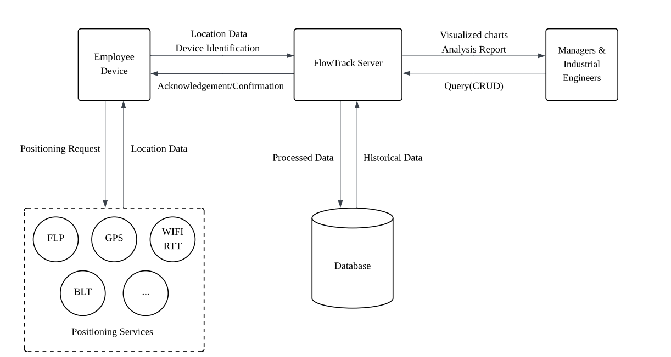
1.1 Context Diagram

Slide 4
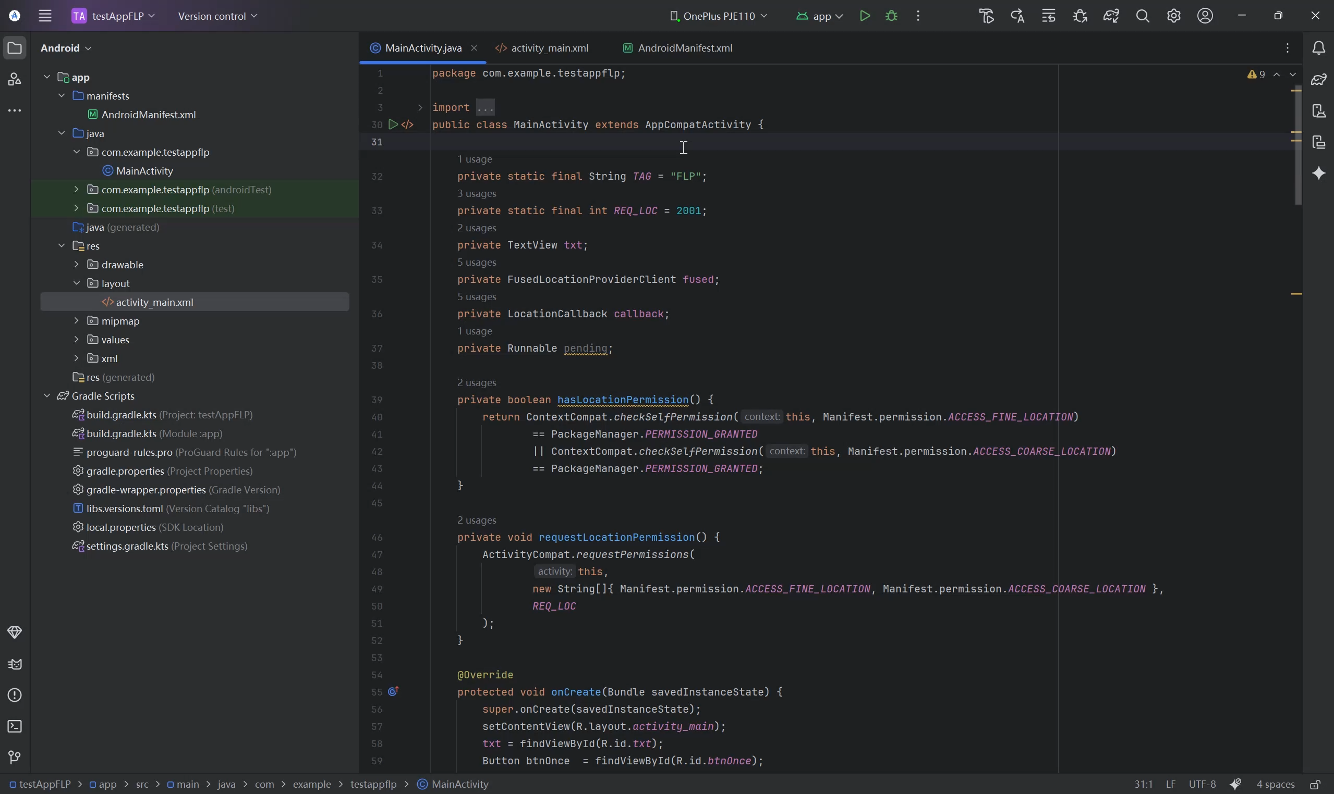
2.1 FLP demo: programming
Programming on Android Studio
link to Android phone via data cable
asking positioning permission

Slide 5
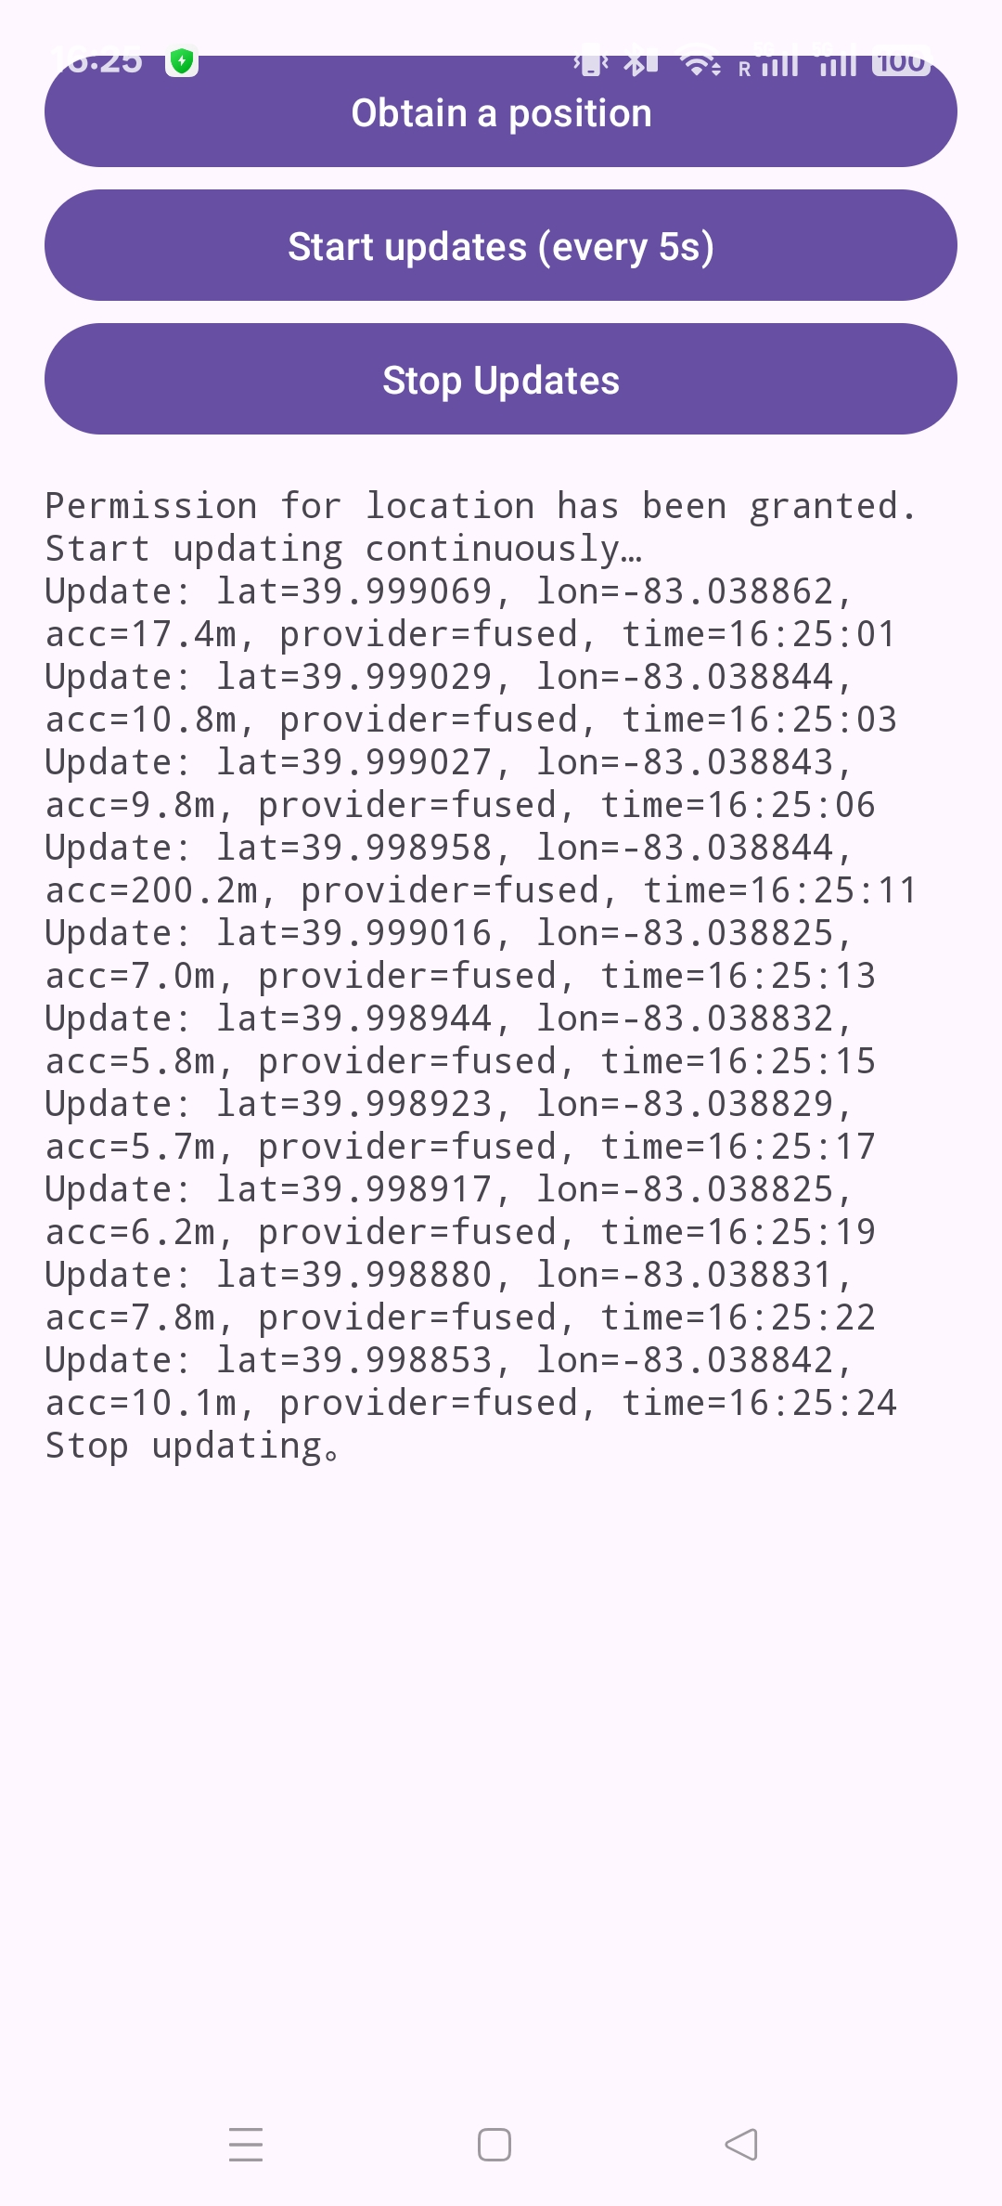
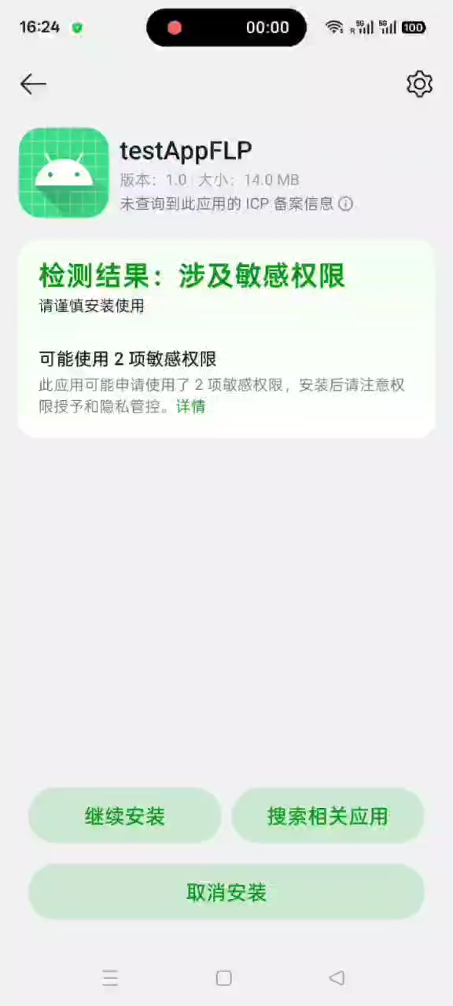
2.1 FLP demo: outdoor
lat / lon — Latitude & longitude
acc — Horizontal accuracy in meters. about 68% chance the true position lies within acc meters (≈95% within ~2×acc).
provider — Source of the fix. Typically fused (Google FLP), sometimes gps or network.
time — Timestamp
What is acc=200m?
Why acc decrease?

Slide 6
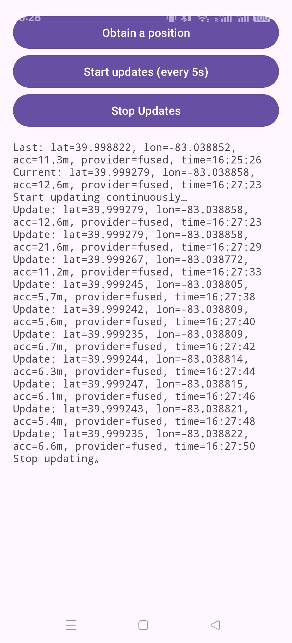
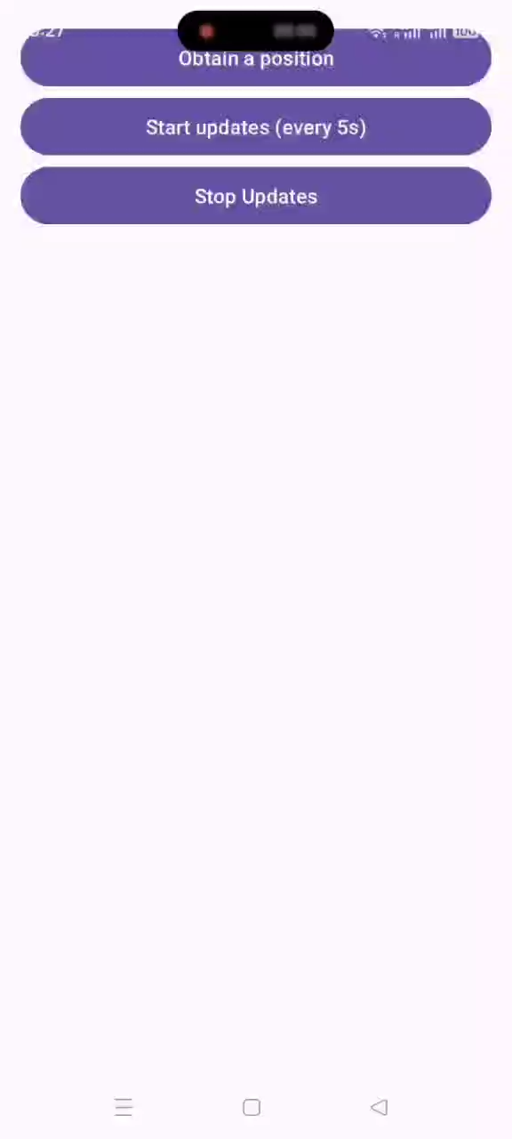
2.1 FLP demo: indoor
Why outdoor has nearly same acc to indoor?

Slide 7
2.1 FLP demo: what’s next
keep developing FLP demo, fulfill other module(database, server…) and functions(better FLP, heat map/from-to map generation…) in order to touch MVP(Minimum Viable Product)
test and try other positioning techs, finally it should be a hybrid positioning strategy

Slide 8
2.2 test and research
WIFI RTT: my Android phone is not support RTT tech, AP
FLP: it works, keep developing
BLE
Inertial Sensors + Pedestrian Dead Reckoning (PDR)

Slide 9
3. Challenge
Equipment limitation
Map-coordinates
ML

Slide 10
Next step
project management
coding

